Slide 1
Operating Systems and Architectures CSCM98, Part 5: Introduction to CPUs
Dr. Benjamin Mora
1
Swansea University
Benjamin Mora

Slide 2
Content
Transistors and Gates
Registers and Arithmetic units
CPU Pipeline
SIMD Programming

Slide 3
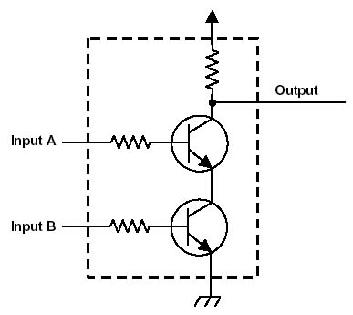
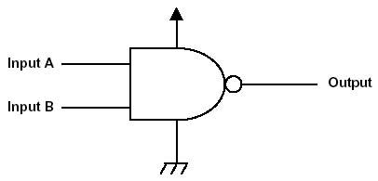
Transistors and Logical Gates
CPUs are made of transistors
These transistors allow creating logical gates like a NAND gate.
From http://cpuville.com/logic_gates.htm
Donn Stewart 2010
A NAND gate
3
Swansea University
Benjamin Mora

Slide 4
Truth Tables
Implemented with Logical gates
A
0 1
A
0 1
and
or
0
1
0 0
0 1
0
1
0 1
1 1
B
B
A
0 1
A
0 1
A
0 1
nand
nor
xor
0
1
1 1
1 0
0
1
1 0
0 0
0
1
0 1
1 0
B
B
B
4
Swansea University
Benjamin Mora

Slide 5
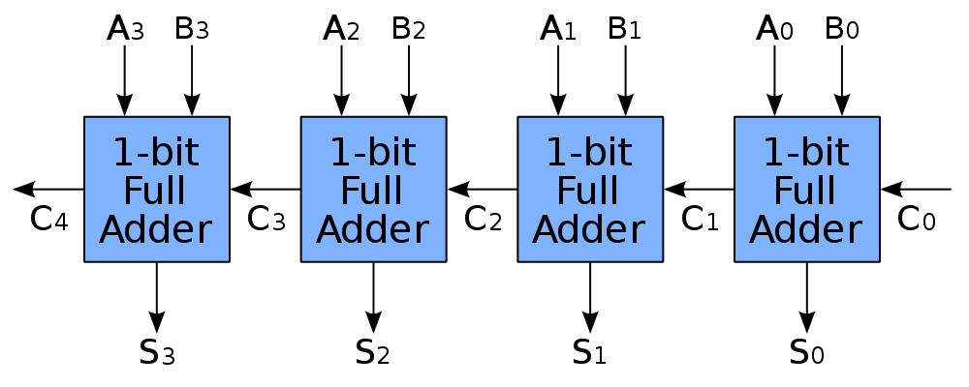
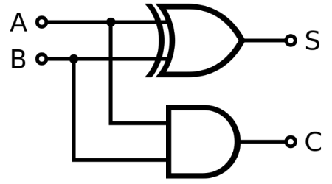
Simple Adder
Logical gates can be combined to create circuits like adders, multipliers, etc…
A 1-bit and 4-bit adders
http://http://en.wikipedia.org/wiki/Adder_(electronics)
Adders can be combined to create n-bits adders (e.g. 32-bit adder, etc).
Multipliers, comparators, tests
More specialized: bit counts, random number generators, etc…
5
Swansea University
Benjamin Mora
Notes:
Carry missing in the 1-bit adder

Slide 6
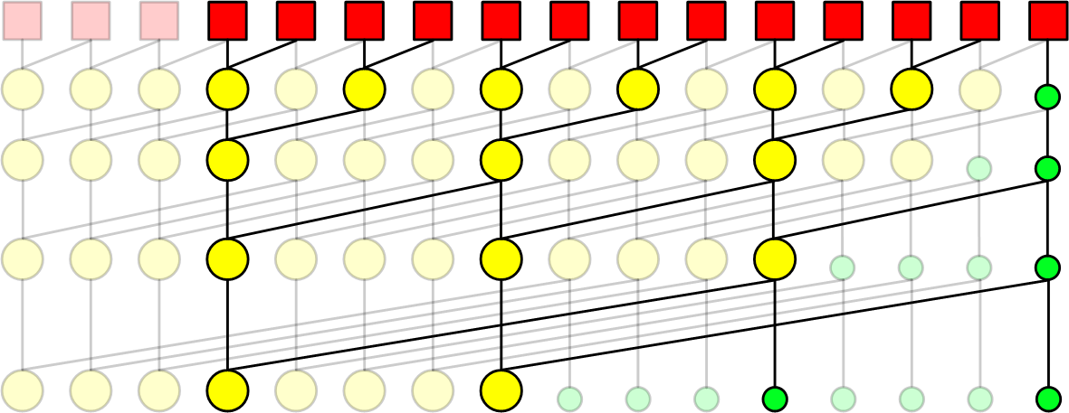
Advanced Adder
There are various ways to implement circuits
Kogge–Stone adder (S=A+B, better than previous design):
http://en.wikipedia.org/wiki/Kogge%E2%80%93Stone_adder
Depth of circuit is important (delay/latency)
And so the number of links (complexity).
And so the maximum distance (signal propagation: latency).
… A2,B2 A1,B1 A0,B0
Bits … S4 S3 S2 S1 S0
6
Swansea University
Benjamin Mora

Slide 7
Implementing Arithmetics in Hardware
Precomputed tables are often implemented in circuits
Shorter latency (just one lookup is needed in the table)
Simplicity (not in term of transistors, but only design).
Limited precision (e.g., 4x4 bit tables)
Does not scale well and requires many transistors.
Use of several iterations (e.g., Newton-Raphson) to get full precision.
Good for implementing specific, difficult circuits.
MUL, DIV, RSQRT (1/Sqrt(x)), RCP (1/x).
7
Swansea University
Benjamin Mora

Slide 8
Registers
What is a program?
i=i+1
Mov R1, i
Add R1, #1
Mov i, R1
ALU
PC
Stack Pointer and Program Counter
SP
i
3
4
R1
3
4
Registers
R2
Memory
8
Swansea University
Benjamin Mora
CPU
Notes:
Or
i = i+1
i <- i+1

Slide 9
A Modern processor
Core #1
L1 Data
Cache
L1 Data
Cache
L3 Data
Cache
ALU
PC
ALU
PC
L2 Data
Cache
L2 Data
Cache
SP
SP
Mov R1, i
Instruction
Cache
Instruction
Cache
R1
Prediction
Cache
R1
Prediction
Cache
Add R1, #1
Mov i, R1
R2
TLB
Cache
R2
TLB
Cache
L1 Data
Cache
L1 Data
Cache
Memory
Bus
ALU
PC
ALU
PC
L2 Data
Cache
L2 Data
Cache
SP
SP
Instruction
Cache
Instruction
Cache
R1
Prediction
Cache
R1
Prediction
Cache
R2
TLB
Cache
R2
TLB
Cache
Memory
CPU
9
Swansea University
Benjamin Mora
Notes:
Or
i = i+1
i <- i+1

Slide 10
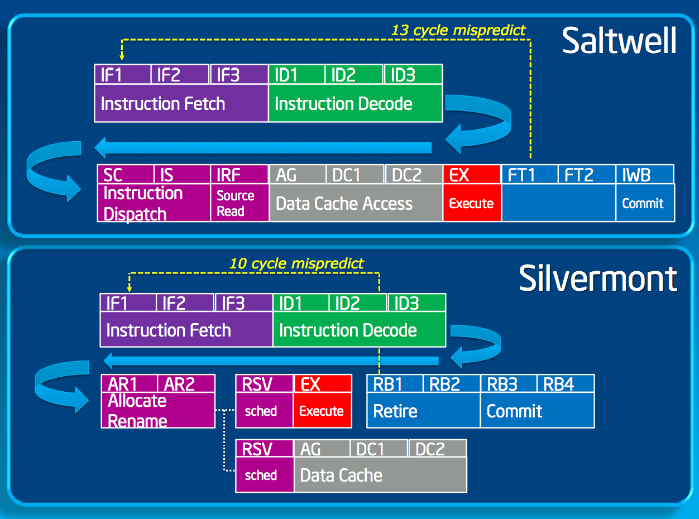
CPU Pipelines
http://www.anandtech.com/show/6936/intels-silvermont-architecture-revealed-getting-serious-about-mobile/2
10
Swansea University
Benjamin Mora
Notes:
More detailed stages

Slide 11
Decoding a Program
The program counter points to the instruction that is currently executed, and then moves to the next one at the next clock cycle unless a (possibly conditional) jump instruction is encountered.
Circuits (adder, etc…) deal directly (and only) with registers, not memory.
Instructions must be scheduled!
Pipeline(d).
Fetch, decode, Execute, write-back stages.
Requires many transistors for scheduling.
Instructions have latencies and throughput associated.
11
Swansea University
Benjamin Mora

Slide 12
Instructions’ Latency and Throughput (X86)
MUL,FMUL,ADD,FADD,SUB,FSUB:
Usually 1 or 2 instructions completed per clock cycle.
Latency of 5 for FMUL.
Really depends on design (processor generation), circumstances (data in caches) and dependencies (if/while instructions).
DIV,FDIV: 10 to 20 clock cycles latency.
IF THEN ELSE (branching instructions)
0/1 cycle if well predicted by CPU (additional transistors)
~10 to ~20 if mispredicted or no branch prediction hardware available (Discussed later)
12
Swansea University
Benjamin Mora

Slide 13
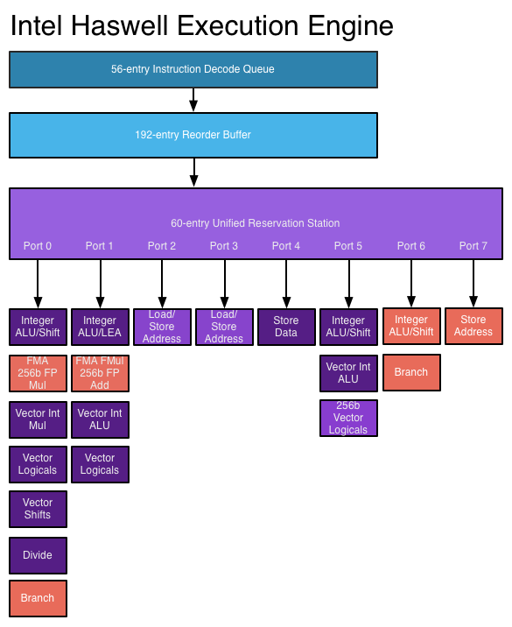
http://www.anandtech.com/show/6355/intels-haswell-architecture/8
13
Swansea University
Benjamin Mora

Slide 14
Intructions’ control flow optimizations
The flow of instructions (Scheduling) should be kept continuous.
Ideally one or several instructions executed per clock.
8 execution ports on Intel’s Haswell (e.g., i7 4770K)
14-stage pipeline, 168-entry register file.
Notion of register has become more logical than physical as they are actually renamed and implemented as a buffer.
Difficult (or more complex):
Branching conditions.
Instruction dependencies.
Out-of-order execution
Instructions should be loaded and decoded first
Caches needed
14
Swansea University
Benjamin Mora

Slide 15
Power Consumption and Multicore
Power consumption of chips does not increase linearly with frequency in general!
Power = Frequency x Voltage²
Solution is to go multicore.
Scales better… provided that algorithms and code do.
Memory
CPU
L3 cache
L2 cache
L2 cache
L2 cache
L2 cache
L1 cache
L1 cache
L1 cache
L1 cache
Core 0
Core 1
Core 2
Core 3
15
Swansea University
Benjamin Mora

Slide 16
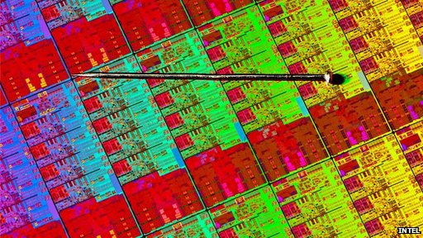
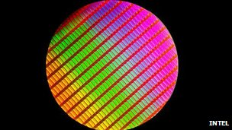
Wafers
http://www.bbc.co.uk/news/technology-19557496
16
Swansea University
Benjamin Mora

Slide 17
CPU’s SIMD Units
Single Instruction Multiple Data
1 instruction to schedule several computations of the same type.
Different from VLIW ! (Very Long Instruction Word)
Can be 4-wide (MMX, SSE, NEON), 8-wide (AVX), 16-wide and more (GPUs)
Can accelerate by as much math operations.
Saves transistors and complexity!
1 operation to be scheduled only.
1 address translation only (see MMU later on)
Several constraints, not all algorithms can easily benefit from SIMD execution units.
Scaling with wide(r) units may be an issue.
17
Swansea University
Benjamin Mora

Slide 18
SIMD Units: Principles
A
3
5
2
3
8
2
5
6
1
2
7
1
4
7
2
3
+
+
+
+
+
+
+
+
+
+
+
+
+
+
+
+
B
1
3
4
1
3
2
8
6
0
0
6
1
8
1
3
1
=
=
=
=
=
=
=
=
=
=
=
=
=
=
=
=
C
4
8
6
4
11
4
13
12
1
2
13
2
12
8
5
4
18
Swansea University
Benjamin Mora

Slide 19
Traditional C program
int A[16] = {3,5,2,3,8,2,5,6,1,2,7,1,4,7,2,3};
int B[16] = {1,3,4,1,3,2,8,6,0,0,6,1,8,1,3,1};
int C[16];
//16 adds!
for (int i=0;i<16;i++)
C[i]=A[i]+B[i];
19
Swansea University
Benjamin Mora

Slide 20
SIMD Units: Principles
A
3
5
2
3
8
2
5
6
1
2
7
1
4
7
2
3
+
+
+
+
+
+
+
+
+
+
+
+
+
+
+
+
B
1
3
4
1
3
2
8
6
0
0
6
1
8
1
3
1
=
=
=
=
=
=
=
=
=
=
=
=
=
=
=
=
C
4
8
6
4
11
4
13
12
1
2
13
2
12
8
5
4
Per-lane operations !
20
Swansea University
Benjamin Mora

Slide 21
SIMD Units: Principles
A
3
5
2
3
8
2
5
6
1
2
7
1
4
7
2
3
+
+
+
+
+
+
+
+
+
+
+
+
+
+
+
+
B
1
3
4
1
3
2
8
6
0
0
6
1
8
1
3
1
=
=
=
=
=
=
=
=
=
=
=
=
=
=
=
=
C
4
8
6
4
11
4
13
12
1
2
13
2
12
8
5
4
Let’s suppose 32-bit integers (int, 4 bytes). For a given architecture, one can fix a computational block/packet size.
What we can have for 64 bytes:
2 blocks of 32 bytes (=8 ints per block, AVX width)!
4 blocks of 16 bytes (SSE width, 4 ints per block)!
21
Swansea University
Benjamin Mora
Notes:
Usually, an int declarations gives you a 4-byte signed integer, but not always!

Slide 22
AVX Coding Using AVX intrinsics
int A[16] = {3,5,2,3,8,2,5,6,1,2,7,1,4,7,2,3};
int B[16] = {1,3,4,1,3,2,8,6,0,0,6,1,8,1,3,1};
int C[16];
//Type casting, No real operation involved.
__m256i *ptA=(__m256i *) A;
__m256i *ptB=(__m256i *) B;
__m256i *ptC=(__m256i *) C;
//Only two instructions as 8 operations are carried out in one //instruction!
ptC[0]=_mm256_add_epi32(ptA[0],ptB[0]);
ptC[1]=_mm256_add_epi32(ptA[1],ptB[1]);
22
Swansea University
Benjamin Mora
Notes:
Missing is a 32-byte alignment of the arrays! Compiler could do it, but it is 16-byte align usually.
Could be 32 operations at a time on bytes.
Intrinsics are pseudo functions matching the hardware specifications, and that tell the compiler to use the hardware instruction when compiling.

Slide 23
SIMD Principles
__m256i represents a 32-byte "array" of integer “nature”.
__m256 for float types.
__m256d for double types (only 4 elements).
_mm256_add_epi32 adds 8 signed 32-bit integers!
epi8, epi16 & epi64 may exist for some instructions
E.g., adding to 16-bit integers
23
Swansea University
Benjamin Mora

Slide 24
1 AVX Register (256 bits/32 bytes)
Bit 0
Bit 256
0
1
2
3
4
5
6
7
float
float
float
float
float
float
float
float
0
1
2
3
double
double
double
double
0
1
2
3
4
5
6
7
8
9
10
11
12
13
14
15
short
short
short
short
short
short
short
short
short
short
short
short
short
short
short
short
24
Swansea University
Benjamin Mora

Slide 25
SIMD Principles
What do you get with 32-byte (not bits) registers?
4 double precision floating point values (double)
8 single precision floating point values (float)
8 32-bit integers (int, signed or not)
16 16-bit integers (short, signed or not)
32 8-bit integers (char, signed or not)
25
Swansea University
Benjamin Mora
Notes:
Standard sizes for C-types, but not in C specs nor a requirement.

Slide 26
SIMD Principles
Most instructions work on a per-lane basis!
Atomicity ensured!
Elements must be consecutively stored in memory and then loaded in a register for processing.
Not all operations are possible!
Binary operators (e.g., AND OR XOR ), MUL, ADD, MIN, MAX, FSQRT, DIV,RCP are quite common operators.
Some cross lanes operations exist!
26
Swansea University
Benjamin Mora

Slide 27
SIMD Principles
Use of intrinsics (pseudo-assembly with types) saves us from typing tedious assembly code.
Intrinsics-based code can be improved with some #defines
#define add8i(a,b) (_mm256_add_epi32((a),(b)))
c=add8i(a,b)
27
Swansea University
Benjamin Mora

Slide 28
Examples of AVX2 instructions
AVX 1 does not support integer operations!
epi8 (char), epi16 (short), epi32 (int), ps (float) are AVX2 extensions.
pd (double).
In-lane examples (specs):
__m256 _mm256_and_ps(__m256 m1, __m256 m2);
__m256 _mm256_or_pd(__m256 m1, __m256 m2);
__m256 _mm256_div_ps(__m256 m1, __m256 m2);
__m256i _mm256_and_epi32(__m256i m1, __m256i m2);
__m256 _mm256_min_ps(__m256 m1, __m256 m2);
__m256 _mm256_max_ps(__m256 m1, __m256 m2);
__m256 _mm256_rsqrt_ps(__m256 m1);
__m256i _mm256_abs_epi32(__m256i s1);
28
Swansea University
Benjamin Mora
Notes:
ps: floating point
epi32 32-bit signed integers

Slide 29
Examples of AVX2 instructions
Special operation: shuffling floating point content:
__m128 _mm_shuffle_ps(__m128 a , __m128 b , const int i );
__m256 _mm256_shuffle_ps(__m256 a , __m256 b , const int i );
c = _mm_shuffle_ps (a,b,0x98); //0x98 = 0b 10 01 10 00 SSE inst., not AVX
00 01 10 11
00 01 10 11
A
3
8
2
5
B
1
4
6
7
00 01 10 11
C
3
2
4
6
29
Swansea University
Benjamin Mora

Slide 30
Examples of AVX2 instructions
The shuffle instruction picks two elements of A and two elements of B.
It requires a const code for blending the two vectors.
AVX 8-wide version only works on two 4-wide sub-arrays, and data cannot cross the middle lane.
Permute instruction to be used as well for AVX instructions!
Different from the previous shuffle instruction!
extern __m256 _mm256_permute2f128_ps
(__m256 m1, __m256 m2, int control);
Benjamin Mora

Slide 31
AVX Permute instruction
C= _mm256_permute2f128_ps(A,B, 0x30);
0x30=0b00110000
}
}
00 01
10 11
A
3
5
2
3
8
2
5
6
B
1
3
4
1
3
2
8
6
C
3
5
2
3
3
2
8
6
00 01
Benjamin Mora

Slide 32
Why do we need shuffling instructions?
To do horizontal operations in several steps
i.e., not per lane operations (unsupported).
Example: fast horizontal min
Removes branching tests!
Also, fast matrix transpose!
00 01 10 11
A
3
8
2
5
B=shuffle(A,A,0xE4)
B
8
3
5
2
A=min(A,B)
A
3
3
2
2
B=shuffle(A,A,0x1B)
B
2
2
3
3
A=min(A,B)
A
2
2
2
2
Benjamin Mora

Slide 33
Examples of AVX instructions
_mm256_min_ps(…)
1 clock cycle throughput
Much better than:
if (a>b) c=b else c=a;
Because of a test (branch)!
Because of multiple instructions.
(Good) compilers can sometimes detect and optimize this C code!
Benjamin Mora

Slide 34
SIMD instructions: Prefetching
Not having data close to the processor is an issue!
Usually around ~50 clock cycles to access memory!
vs. ~1 instruction per clock cycle usually (throughput)
Difference/delay is not acceptable.
Cache(s) will minimise the problem.
Using any data (e.g. an int variable) in code often requires at least one load and so prefetching was invented...
Process here
Prefetch here
Prefetch distance
3
5
2
3
8
2
5
6
…
2
7
1
4
7
2
3
Processing order
Benjamin Mora

Slide 35
SIMD instructions: Prefetching
Prefetch instruction:
void _mm_prefetch(char * p , int i );
i variable for specifying which cache is concerned.
Automatic prefetching done by modern processors
Slightly less efficient.
Mainly loading adjacent cache lines.
Prefetch distance depends on the case.
Make sure you do not prefetch a non valid cache-line.
Not allocated, not written memory area!
Typically end of array!
Benjamin Mora
Notes:
Prefetching prefetches a full line of cache (64 aligned bytes) around the pointer address (which points to a specific byte!). i can be set to for instance _mm_hint_t0 to specify the Level 0 cache, i.e. the one closest to the processor.

Slide 36
Other useful SIMD instructions
Streaming stores
Bypass L2 and L3 caches without polluting them.
See lecture on caches.
E.g. void _mm_stream_ps(float * p , __m128 a );
(SSE instruction)
Getting masks (i.e., highest bits)
extern int _mm256_movemask_ps(__m256 a);
int B= _mm256_movemask_ps(A);
A
0
1
2
3
4
5
6
7
-0.3f
1.f
-5.f
2.f
1.f
-1.f
-1.f
10.f
B=0b01100101=64+32+4+1=99
Benjamin Mora

Slide 37
SIMD instructions: Prefetching
Streaming stores improve bandwidth when dealing with large streams of data (read once, write once).
movemask instructions allow on integer to store some binary state about a full SIMD register
Can be used with other instructions like bitcount instructions or lookup tables.
E.g., counting how many positive values contained inside an SIMD register.
E.g., Radix sort.
Benjamin Mora

Slide 38
Other useful SIMD instructions
Integer/Float conversions
Random Number Generation (AVX 2)
E.g., _rdrand32_step(unsigned int *)
Encryption/Decryption
AES-128
40 steps
AES-192
48 steps
AES-256
56 steps
Benjamin Mora
Notes:
__m256 __cdecl _mm256_i32gather_ps(float const *, __m256i, const int );

Slide 39
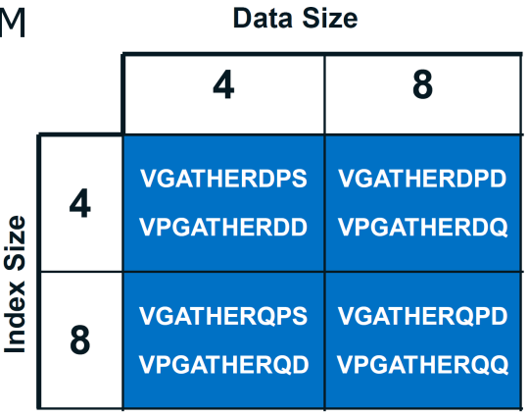
Other useful SIMD instructions
Gather/Scatter operations.
Gather implemented in AVX2
__m256 __cdecl _mm256_i32gather_ps
(float const *, __m256i, const int );
Returns 8 floats packed in an AVX register from a float address and 8 32-bit indices.
i.e. computing v=A[i] in parallel.
Throughput still low!
Benjamin Mora

Slide 40
Other useful SIMD instructions
String: Packed comparisons (introduced with SSE 4.2)
Sum of absolute differences
For image compression
__m128i _mm_mpsadbw_epu8( __m128i a, __m128i b, const int mask );
Reciprocal, RSQRT
Requires a Newton-Raphson iteration for better precision (22 bits).
Fast implementation.
Benjamin Mora

Slide 41
Data Structures and memory Linearity (C)
typedef struct { float x; float y; float z;} Point;
Point myPoints[2];
Point #0
Point #1
x
y
z
x
y
z
Memory address
Notes:
The way data is stored is crucial to understand when it comes to optimizations. Memory bandwidth is one of the most limiting factors and should be carefully thought about. This is especially important when dealing with SIMD units

Slide 42
SIMD Programming: Data Structures
Structures need to be aligned for best performances!
16-byte (SSE) or 32 bytes (AVX)
Arrays of Structures VS Structures of Arrays!
AoS vs SoA
Example: A set of 3D points:
Point #0
Point #1
Point #2
…
x
y
z
x
y
z
x
y
z
x
y
z
x
y
x
…
AoS
or
…
x
y
z
NA
x
y
z
NA
x
y
z
NA
NA
x
y
x
…
#0
#1
#2
#3
…
x
x
x
x
…
SoA
y
y
y
y
…
Benjamin Mora
z
z
z
z
…

Slide 43
SIMD Programming: Data Structures
Structures of Arrays better at handling:
Read-only data
Processed in large consecutive chunks
Arrays of Structures better at handling:
Reconfigurable data
More random access patterns (never a good thing)
Due to increased cache locality.
Often requires extra operations (like a transpose) to put things back in order.

Slide 44
SIMD Programming: Data Structures
Intermediate representation can be useful sometimes
Array of Structures of Arrays (AoSoA)
Point #0
x₀
x₁
x₂
x₃
y₀
y₁
y₂
y₃
z₀
z₁
z₂
z₃
x₄
x₅
x₆
x₇
…
Notes:
Prefetching prefetches a full line of cache.
(i.e. 4-wide SIMD, R1: XXXX, R2:YYYY, R3:ZZZZ)

Slide 45
IEEE floating-point representation
1 float representation (32 bits used)
X=(-1)^{s}(1+M)2^{E-127}
1
0
0
1
1
0
0
1
1
0
0
1
0
0
0
1
0
0
0
1
1
0
0
0
0
0
0
0
1
0
0
1
Sign
Exponent
Mantissa
Benjamin Mora

Slide 46
IEEE floating-point representation
Absolute Value without branching
float x=…;
unsigned int abs=0x7FFFFFFF;
x=x & ((float &) abs);
Works well with SIMD instructions!
Explains why AVX2 abs (absolute value) instruction implemented in hardware for integers, but not for floating point values.
Benjamin Mora

Slide 47
IEEE floating-point Representation
float myFunction( float number )
{
long i; float x2, y;
const float threehalfs = 1.5F;
x2 = number * 0.5F;
y = number; i = * ( long * ) &y;
// evil floating point bit level hacking
i = 0x5f3759df - ( i >> 1 ); // what the fuck?
y = * ( float * ) &i;
y = y * ( threehalfs - ( x2 * y * y ) );
// 1st iteration
// y = y * ( threehalfs - ( x2 * y * y ) );
// 2nd iteration, this can be removed
return y;
}
Quake 3 Arena code (Wikipedia).
Any idea about what it does?
Benjamin Mora
Notes:
http://en.wikipedia.org/wiki/Fast_inverse_square_root
John Carmack evil Fast inverse square root implemented in Quake3!

Slide 48
Further Reading
Verilog.
VHDL.
Various Circuit designs.
48
Swansea University
Benjamin Mora

Slide 49
Other topics seen separately
Transactional memory.
Cache.
TLB
MMU
Cache trashing.
49
Swansea University
Benjamin Mora

